Slide 1
OPER 623 – Heuristic Search Methods
Lesson 9 – Greedy Randomized Adaptive Search Procedure (GRASP)

Slide 2
GRASP!
GRASP is one of those heuristics, where once you are told it, you think “Well I could have come up with that!”
Instead of explicitly telling you the heuristic, I am going to try to lead you down the path to coming up with it yourself.
Why?
  Increase your heuristic building confidence.
  Get you thinking so you are more experienced later on (project, thesis, future jobs).
  Hopefully as you are thinking of this, you are determining the pros and cons of adopting such a procedure for a heuristic.

Slide 3
Outline
Nearest Neighbor Revisited
GRASP: Step 1
Hybrid Heuristics
GRASP
Examples
  Set Cover
  Maximum Independent Set

Slide 4
Nearest Neighbor
What were the advantages and disadvantages of the Nearest Neighbor Heuristic?
Ideally, we would like to alter Nearest Neighbor slightly such that it remains easy to comprehend, communicate, and implement, but improves our chance of arriving at a high-quality solution.
What if we made Nearest Neighbor semi-greedy?
  What do you think that means?

Slide 5
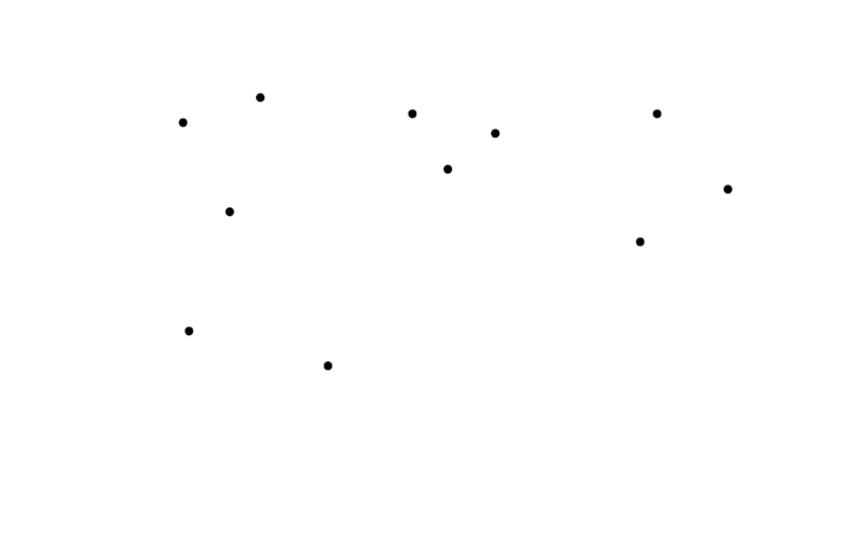
Nearest Neighbor Heuristic

Slide 6
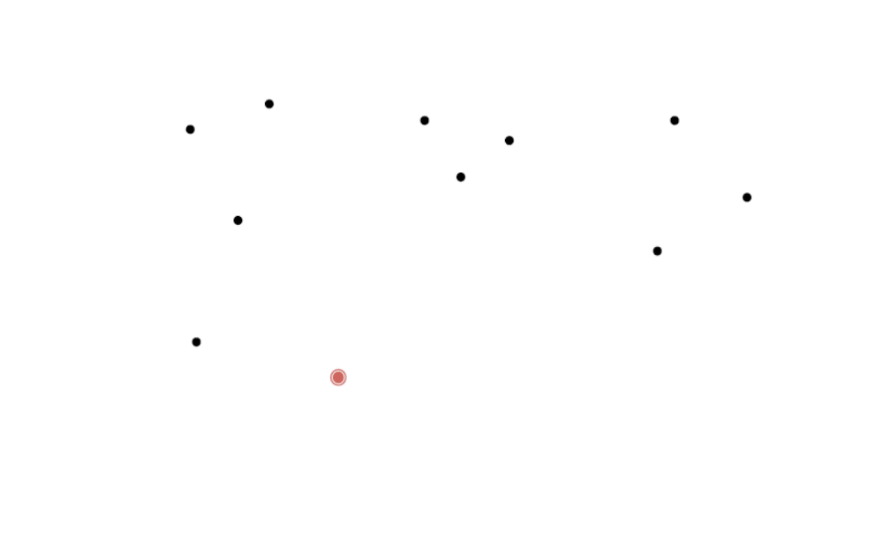
Nearest Neighbor Heuristic

Slide 7
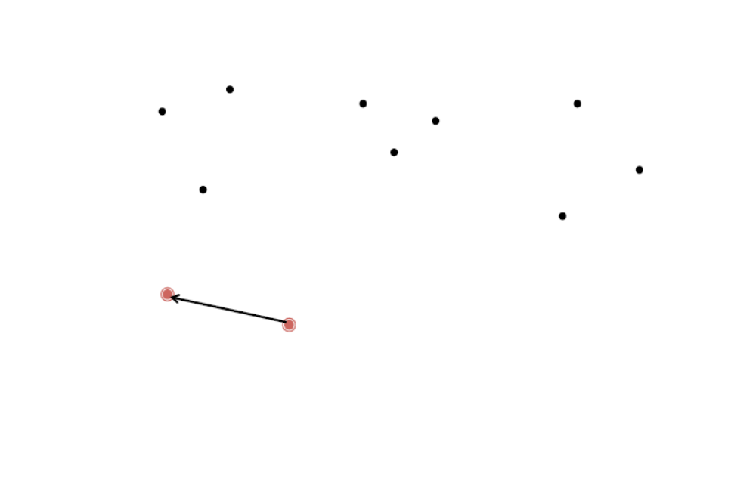
Nearest Neighbor Heuristic

Slide 8
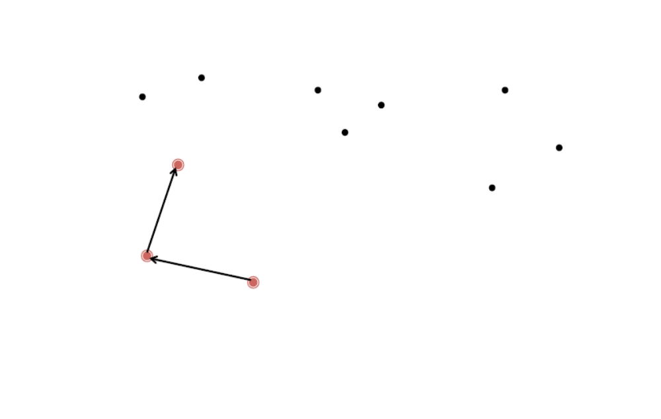
Nearest Neighbor Heuristic

Slide 9
Outline
Nearest Neighbor Revisited
GRASP: Step 1
Hybrid Heuristics
GRASP
Examples
  Set Cover
  Maximum Independent Set

Slide 10
Probabilistic Element for
Nearest Neighbor
Could you add a random element to this?
Instead of always selecting the greedy choice, select from a set of options where each option has a probability that you will pick it.
Is this going to help us, hurt us?
DAU Answer… It depends.
With a deterministic heuristic, provided you start with the same node, you will always end up with the same solution.
This stochastic approach allows for different solutions found even starting with the same node.

Slide 11
Step 1: GRASP
Create a full solution using a semi-greedy approach
  With a semi-greedy approach, you need to determine a Restricted Candidate List (RCL)
  An RCL is the set of places you can select next.
    RCL is a subset of all neighbors
How do you think we could make this restricted candidate list?
Typically, there are two ways:
  The set of all possibilities within p% of the best (greediest) choice.
  The top l possibilities.

Slide 12
Nearest Neighbor Heuristic

Slide 13
Outline
Nearest Neighbor Revisited
GRASP: Step 1
Hybrid Heuristics
GRASP
Examples
  Set Cover
  Maximum Independent Set

Slide 14
Hybrid Heuristics aka Meta Heuristics
Aptly named, hybrid heuristics combine elements of different heuristics.
This could involve the combination of two constructive heuristics, where one is employed at certain times and the other at the… other times.
  Or even more then two construction heuristics!
Most often, it refers to heuristics that have both a constructive and local search element.
The combination of different heuristics makes the solution method more sophisticated, hopefully designed in such a way to arrive at higher quality solutions in a quick amount of time.

Slide 15
Outline
Nearest Neighbor Revisited
GRASP: Step 1
Hybrid Heuristics
GRASP
Examples
  Set Cover
  Maximum Independent Set

Slide 16
Steps 2 and 3: GRASP
Perform a local search on the semi-greedy full solution found in step 1.
  Continue until you cannot find a better solution.
  The specific neighborhood and local search that you use is customizable to your specific problem.
If this solution is better than any other currently found, keep, otherwise, throw away.
Repeat steps 1 through 3 for m iterations.

Slide 17
GRASP Pseudocode
Input: Problem instance
Number of iterations = m
from 1 to m:
  Solution = Construct Semi-Greedy Randomized Solution(Input)
  While true
    False
    Solution = Local Search (Solution, Input)
    if Solution better than Best Solution then
      Best Solution = Solution
    True
    end if
Return Best Solution

Slide 18
GRASP Customizations
If you are implementing GRASP for a problem, what types of customizations do you need to make?
  Number of Iterations m
  Restricted candidate list criteria, p or l
  Semi-Greedy Construction Procedure
  Local Search strategy

Slide 19
GRASP History
J. P. Hart and A. W. Shogan. Semi-Greedy Heuristics: An Empirical Study. Operations Research Letters, Vol 6, No. 3, pp. 107-114, July 1987.
T. A. Feo and M. G. C. Resende. A probabilistic heuristic for a computationally difficult set covering problem. Operations Research Letters, Vol. 8, No. 2, pp. 67-71, April 1989.
T. A. Feo and M. G. C. Resende. Greedy Randomized Adaptive Search Procedures. Journal of Global Optimization, Vol. 6, No. 2, 109-133, March 1995.
L.S. Pitsoulis and M. G. C. Resende. Greedy Randomized Adaptive Search Procedures.
M. G. C. Resende and C. C. Ribeiro. Greedy Randomized Adaptive Search Procedures. Handbook of Metaheuristics.

Slide 20
Outline
Nearest Neighbor Revisited
GRASP: Step 1
Hybrid Heuristics
GRASP
Examples
  Set Cover
  Maximum Independent Set

Slide 21
Set Cover
INPUT:
  Set of n sets P₁, P₂,…, P_{n}.
  Set of m elements 1, 2, …,m.
PROBLEM: Select a subset of the n sets such that you cover all of the m elements.
Step 1: Construct a greedy randomized solution.
  The pure greedy method selects the set with the highest degree of “uncovered” elements.
  This randomized greedy approach will use a value restriction to determine RCL
    Enter RCL if within 40% of the greedy solution.

Slide 22
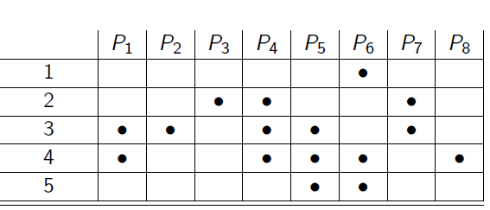
Set Cover Step 1

Slide 23
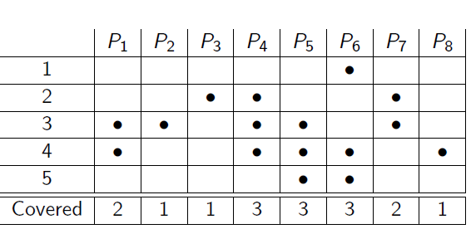
Set Cover: Step 1

Slide 24
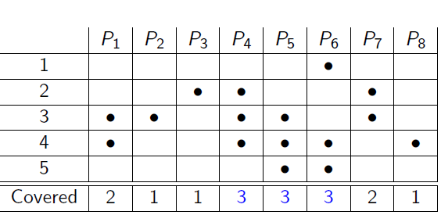
Step 1: Calculate the RCL
p = 0.4
RCL (restricted candidate list):
3 * 0.4 = 1.2 All solutions with degree greater than or equal to 1.2 are in RCL.

Slide 25
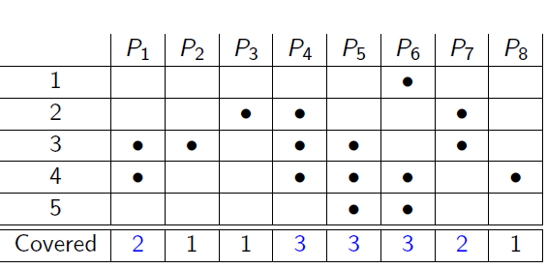
Step 1: RCL List
RCL (restricted candidate list):
3 * 0.4 = 1.2 All solutions greater than or equal to 1.2 are in RCL.
Randomly choose one set from the RCL

Slide 26
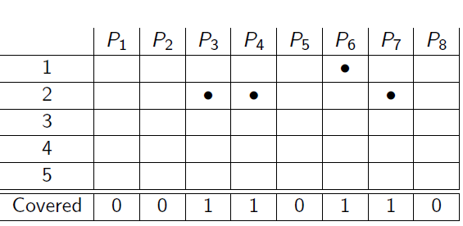
Step 1: Finish constructing sol’n
Remove covered sets and continue semi-greedy randomized construction

Slide 27
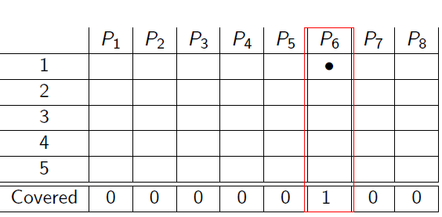
Step 1: Finish constructing sol’n
Full Solution:
Set Cover = {P₅, P₃, P₆}

Slide 28
Step 2: Local Search
Perform a Local Search
  k/p-exchange: For all k-tuples in a cover, if possible, exchange the k-tuple with a p-tuple (p < k) not in the cover.
  For example: k = 2, p = 1:
    Consider each combination of 2 sets from the cover,
    See if you can exchange these 2 with any 1 set not in the cover and still maintain a valid cover.

Slide 29
Step 2: Example
In our example, we have 3 sets in the cover.
  {P₅, P₃, P₆}
We now consider every combination of 2 sets:
  P₅, P₃
  P₃, P₆
  P₅, P₆
For each of these combinations, we determine if we can replace these 2 sets with 1 set not in the cover.

Slide 30
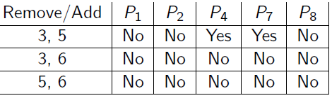
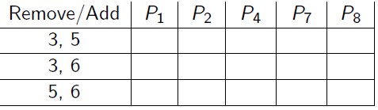
Step 2: Example
Replace solution = {P₅, P₃, P₆} with,
Solution = {P₄, P₆}
Check 2/1 exchanges – none are feasible as no single set covers all elements

Slide 31
Set Cover: Steps 3-4
Return the new cover {P₄, P₆} from Step 2.
Step 3: Check if this new cover is better (smaller) than the current cover (or if it is the first one). If it is better, keep track of {P₄, P₆} is the best known cover so far.
Step 4: Repeat this process (Steps 1 to 3) for m iterations.
For this small example, we do find an optimal solution (i.e. a cover of size 2).

Slide 32
Maximum Independent Set Step 1
Step 1: Construct a greedy randomized solution.
  A pure greedy choice could be to select the node with the smallest degree.
  This randomized greedy approach will use a value restriction and pick one of the nodes with degree within 60% of the greedy solution.

Slide 33
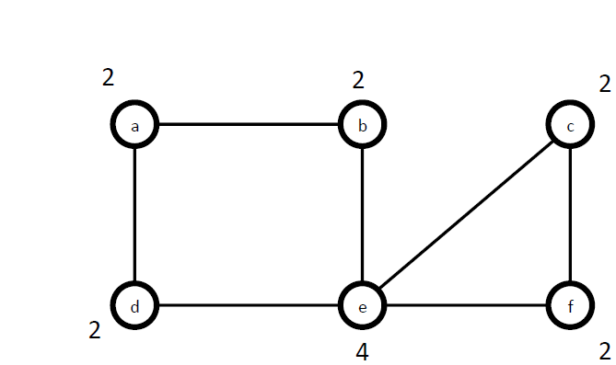
Maximum Independent Set Step 1

Slide 34
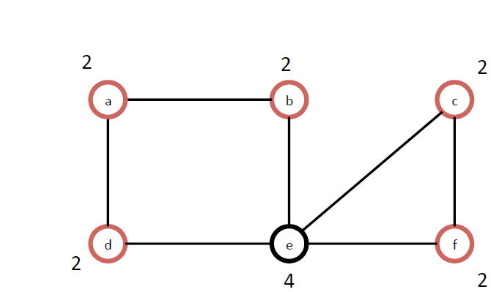
Maximum Independent Set Step 1
Calculate RCL:
2 (1 + 0.6) = 3.2

Slide 35
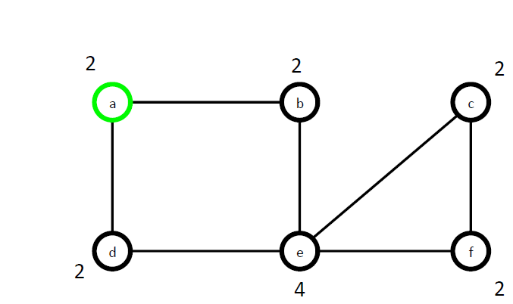
Maximum Independent Set Step 1
Choose one of the members of RCL at random

Slide 36
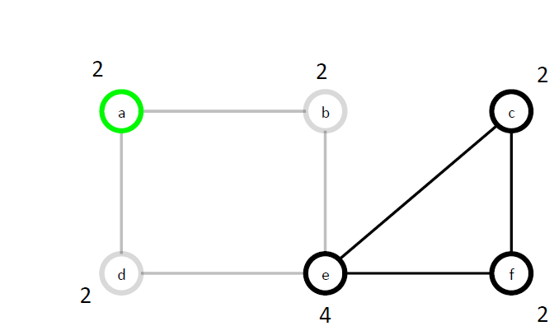
Maximum Independent Set Step 1
This choice removes all connected nodes

Slide 37
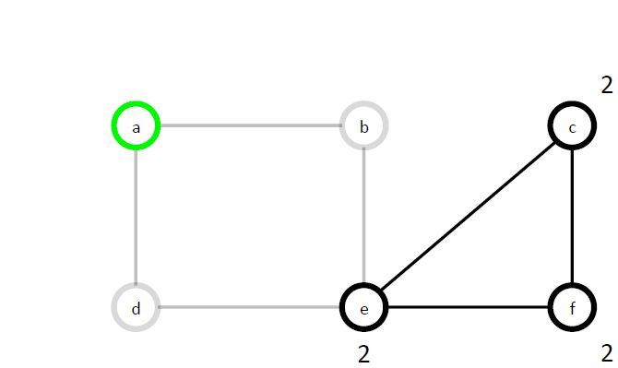
Maximum Independent Set Step 1
Recalculate node degrees

Slide 38
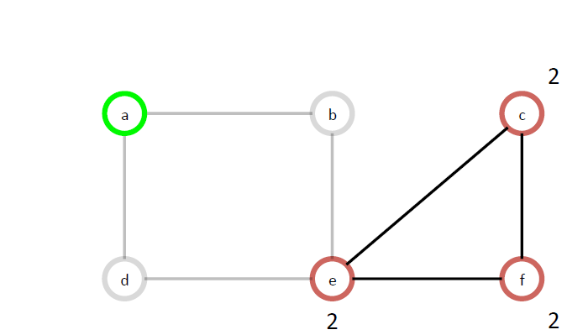
Maximum Independent Set Step 1
Redo RCL list – Now all nodes in our toy example

Slide 39
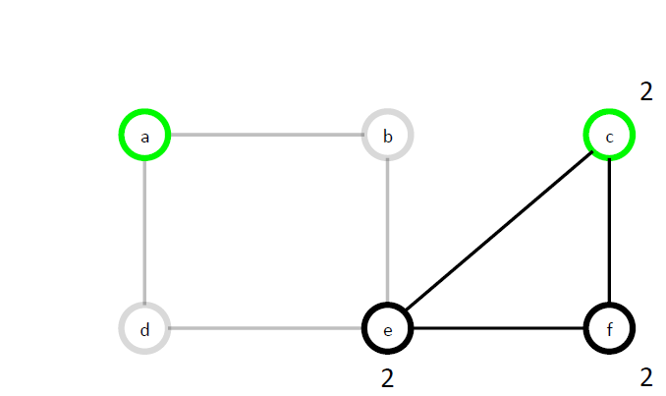
Maximum Independent Set Step 1
Choose one at random

Slide 40
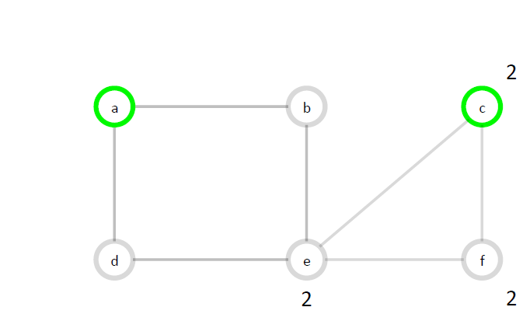
Maximum Independent Set Step 1
Redo covered nodes
Initial full solution

Slide 41
Maximum Independent Set Step 2
Perform a local search on the semi-greedy solution found.
  k-exchange: Consider an independent set of size p and consider all k-tuples of nodes in the set 0 < k < p.
  For each k-tuple, consider removing those k nodes and apply an exhaustive search to find a maximum independent set in the resulting graph.
  For example: for this instance we found a solution with p = 2. We then must have k = 1. We examine each node individually (1-tuple), remove it from the independent set and try to find a maximum independent set on the graph not adjacent to the remaining nodes in the cover.

Slide 42
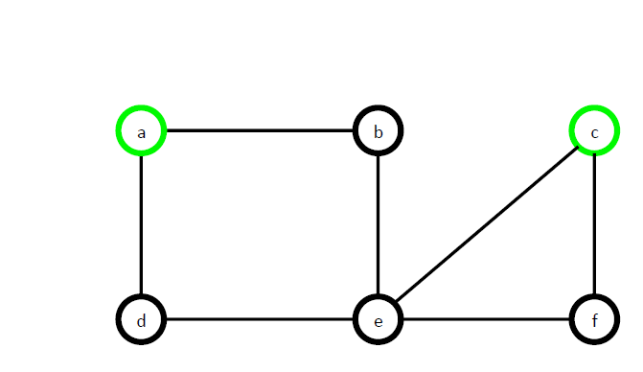
Maximum Independent Set Step 2
Choose one of the two nodes in independent set,
and remove it.

Slide 43
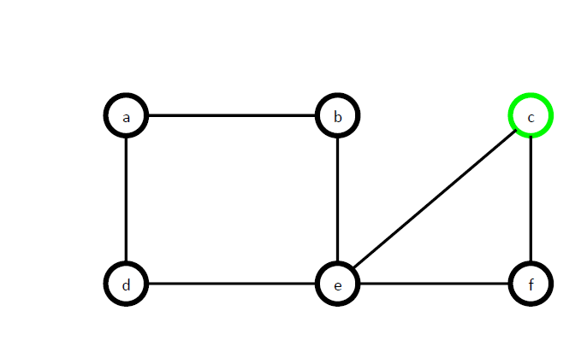
Maximum Independent Set Step 2

Slide 44
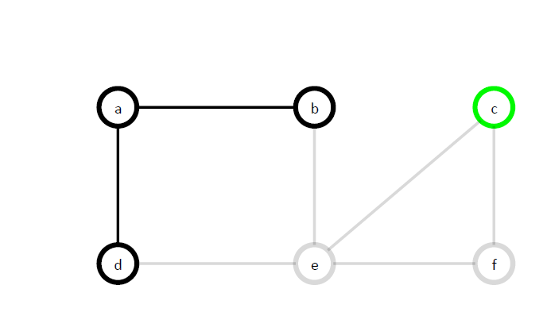
Maximum Independent Set Step 2
Update list

Slide 45
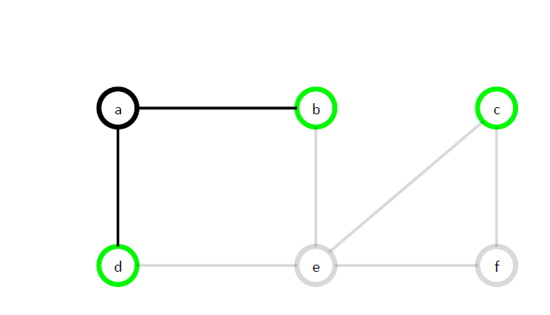
Maximum Independent Set Step 2
Find largest independent set on this revised graph

Slide 46
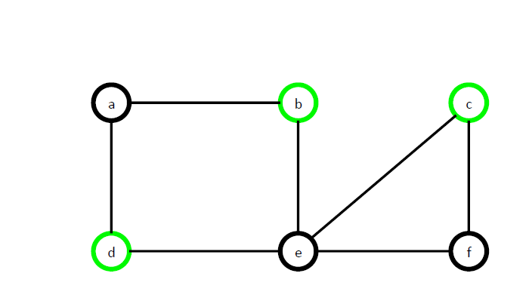
Maximum Independent Set Step 2
New independent set has 3 nodes in it.

Slide 47
Maximum Independent Set
Steps 2, 3, 4
Step 2: We would do the same thing for the 1-tuple = {c} and determine the maximum independent set without this node.
  No Change
Step 2 returns the maximum set found
  {b, c, d}.
Step 3: Check if this new set is better (larger) than the current set (or if it is the first feasible solution). If it is better, keep track of {b, c, d} as the best known set so far.
Step 4: Repeat this process (Steps 1 to 3) for m iterations.

Slide 48


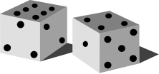
GRASP
Local search
to get local optima
Feasible
Solns
Choice
of p
Greedy Randomized
Heuristic
φ

Slide 49
Basins of Attraction
1st outcome from semi-greedy construction
A slight change due to semi-greedy construction
Randomization allows us to see different parts of sol’n space
2nd outcome from semi-greedy construction
Local search “rolls” solution down towards local minima
Both constructive and local search heuristics have tendency to get trapped by local minima
GRASP proposes the way forward (which will be explored more in our future meta-heueristics)
  Randomization!

